Slide 1
Objet Collection Microsite AU

Slide 2
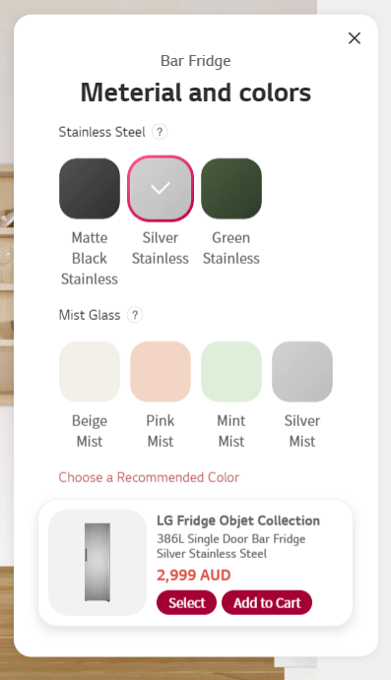
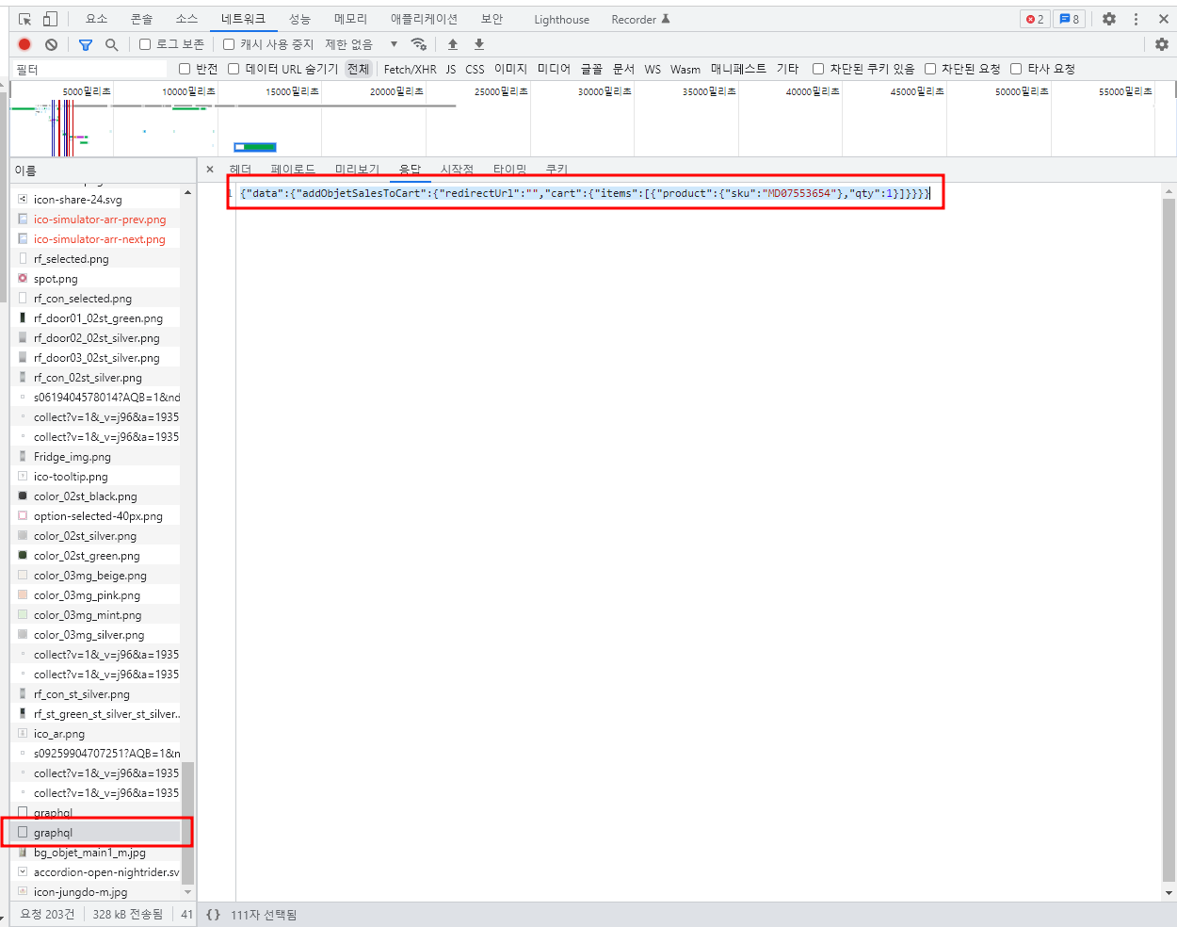
Experience → Bar Fridge (Default:Silver Stainless) → Add to Cart
Ajax Data send
{"query":"mutation { addObjetSalesToCart( input: { cartItems: [{ data :{ sku : \"MD07553654\" , qty :1}, zipcode :\"2000\"}] }) {redirectUrl cart { items { product { sku } qty } } } }","variables":null,"operationName":null}
GraphQL Response
{"data":{"addObjetSalesToCart":{"redirectUrl":"","cart":{"items":[{"product":{"sku":"MD07553654"},"qty":1}]}}}}

Slide 3

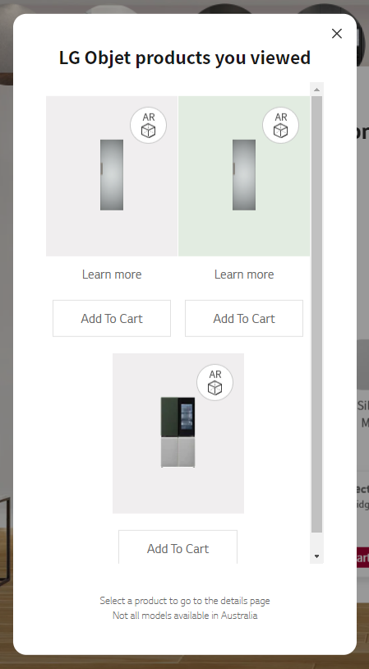
Experience → Bar Fridge (Default:Silver Stainless) → Cart Button → Add to Cart
Ajax Data send
{"query":"mutation { addObjetSalesToCart( input: { cartItems: [{ data :{ sku : \"MD07553654\" , qty :1}, zipcode :\"2000\"}] }) {redirectUrl cart { items { product { sku } qty } } } }","variables":null,"operationName":null}
GraphQL Response
{"data":{"addObjetSalesToCart":{"redirectUrl":"","cart":{"items":[{"product":{"sku":"MD07553654"},"qty":1}]}}}}

Slide 4
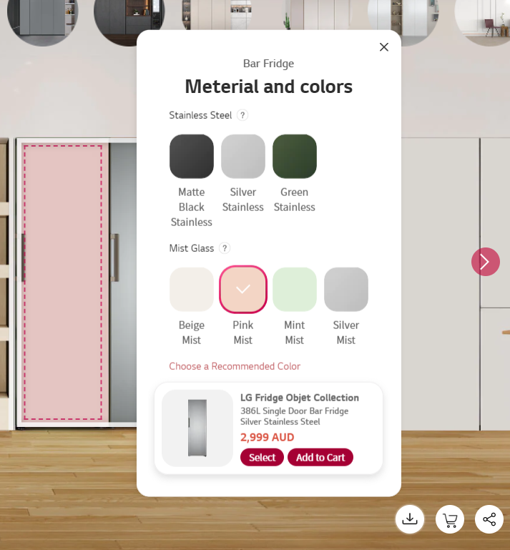
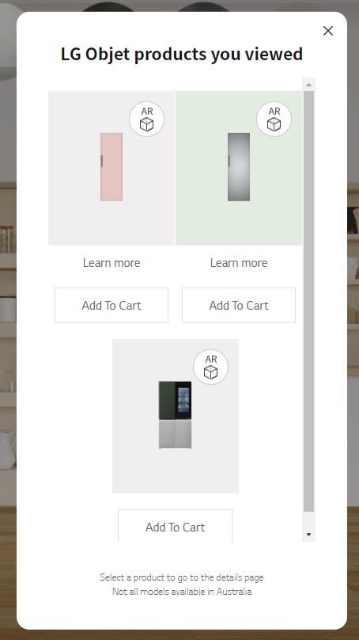
Experience → Bar Fridge (Pink Mist) → Cart Button → Add to Cart
Next →

Slide 5
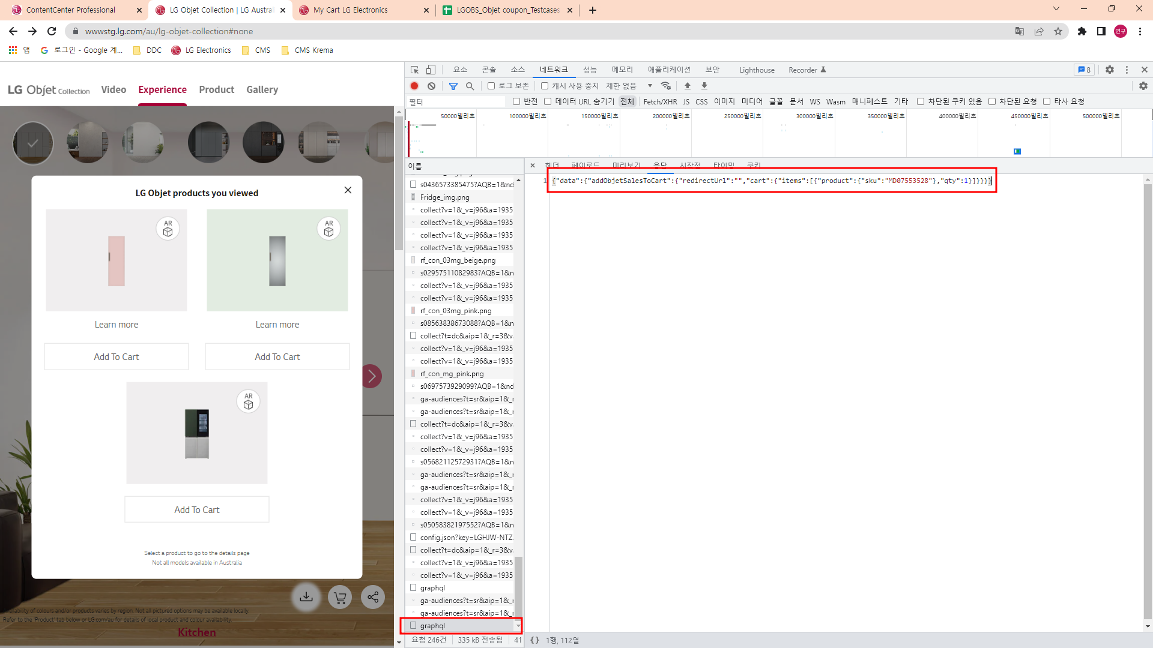
Ajax Data send
{"query":"mutation { addObjetSalesToCart( input: { cartItems: [ { data: { sku: \"MD07553528\", qty: 1 }, zipcode: \"2000\" lg_custom_options: { objet_sales_options: \"AGF30133495,pink,glass\" parent_sku:\"MD07553654\" } }] }) { redirectUrl cart { items { product { sku } qty } } } }","variables":null,"operationName":null}
GraphQL Response
{"data":{"addObjetSalesToCart":{"redirectUrl":"","cart":{"items":[{"product":{"sku":"MD07553528"},"qty":1}]}}}}
<문의사항>
GraphQL Response에 json 데이터가 들어오긴하는데 정상적으로 작동이 되는건지 확인이 필요합니다.
2. 다른 판넬 색상을 선택했을경우, GraphQL Response 값이 본품 데이터값만 들어오는게 맞는지 확인이 필요합니다.

